Slide 1

Guide to Networking Essentials, 9e
Chapter 13: The Internet of Things (IoT)
.

Slide 2
Chapter Objectives
By the end of this chapter, you should be able to:
Define the Internet of Things and list use cases
Describe IoT network technologies
Discuss a variety of IoT devices
Utilize DIY IoT devices

Slide 3
Introduction to the Internet of Things
The Internet of Things (IoT) is the digitization of items through the use of networked microprocessors and microcontrollers along with sensors, actuators, motors, and other I/O devices, plus software
Examples of IoT:
Amazon Echo or Google Assistant
Smoke detectors, motion sensors, and intelligent thermostats
Water pumps
Between 17 and 18 billion IoT devices are estimated to be connected to the Internet in 2024
youtube.com/watch?v=81GdhsfDnsg

Slide 4
IoT Use Cases (1 of 3)
IoT and Transportation
Google uses location, speed, and direction information provided by smartphones being used on roads to detect traffic jams or accidents
Self-driving cars are filled with sensors, communication devices, and microprocessors
IoT and Energy
Utility usage patterns can be used to determine peak usage periods and even detect leaks or illegal activity
IoT is being used to improve operator safety in mining for energy products such as coal and natural gas

Slide 5
IoT Use Cases (2 of 3)
IoT and Manufacturing
The majority of machines used in manufacturing are not connected to a network, but most would benefit from such a connection
IoT can be used to monitor the status of equipment and detect potential problem indicators such as excessive heat build-up, excessive vibration, or too many operation cycles between standard and maintenance tasks
Data-driven manufacturing reduces waste in material goods and energy

Slide 6
IoT Use Cases (3 of 3)
IoT and Emergency Services
IoT can be used to locate victims
Wearable fitness devices could monitor respiration, blood pressure, temperature, and other vital signs and could be sent to a mobile diagnostic device carried by a first responder
Emergency responders may also carry specialized sensors to collect data from the environment and the victim
Robots are being used to investigate dangerous environments such as collapsed buildings or mine shafts, and to investigate suspicious objects that could contain explosives

Slide 7
IoT Technologies (1 of 3)
The goals of most IoT technologies are to collect, process, analyze, react to, and communicate data
Any technology that does one or more of those tasks is a candidate for use in IoT applications
IoT Data Collection
Common types of sensors used in IoT include:
Audio sensors, proximity sensors, light sensors, accelerometers and gyroscopes, temperature and humidity sensors, motion and occupancy sensors, biometric sensors

Slide 8
IoT Technologies (2 of 3)
IoT Data Processing
IoT data processing occurs in two places:
The front end, where the sensors collect the data are located; this is often referred to as edge processing or edge computing
The back end, a central location where data is usually sent via a network connection
A microcontroller is a small, low-power processor with built-in analog and digital I/O lines and memory that usually runs at speeds measured in the tens of Megahertz
A microcontroller is usually at the heart of an embedded system, a computing system designed to perform a specific function

Slide 9
IoT Technologies (3 of 3)
IoT Data Communication
Various consortiums are in the process of developing standards for IoT communications
The communication aspect of IoT is complex because so many of the “things” that generate data are incompatible with one another or lack modern communication technologies and protocols
youtube.com/watch?v=w0bZrOG9WR0
Data – Deception IoT

Slide 10
IoT Networking (1 of 2)
Different types of devices and different environments dictate what type of networking technology is likely to be used by a particular IoT device
Many IoT devices use some form of wireless communication
The network technology used by an IoT device largely depends on the following factors:
Distance
Bandwidth
Power consumption

Slide 11
IoT Networking (2 of 2)
Primary IoT area network types and some of the technologies they are likely to use include the following:
Neighborhood area network (NAN)—primarily used in the utility industry to wirelessly collect data from utility meters
A similar network type, a field area network (FAN), is also used in utility applications and works with NAN technologies
Local area network (LAN)—IoT devices use the same LAN technologies that any connected computing device might use
Personal area network (PAN)—PANs use short-range network technologies such as 802.15 Bluetooth

Slide 12
IoT Networking Technologies Overview (1 of 3)
Wired technologies are sometimes used in IoT—however, wireless dominates the field in most applications
802.11 Wi-Fi—IoT devices can use one of the 802.11 Wi-Fi LAN standards if the bandwidth requirements are high and power is plentiful
Bluetooth—There are IoT-specific revisions to the Bluetooth standard (Bluetooth 4.2 and 5.0)
Bluetooth 6.0 includes improved distance measurement between devices for enhanced security and other improved reliability features
Zigbee, 6LoWPAN, and Thread—These technologies are based on IEEE 802.15.4, which specifies low-bandwidth, low-power, and inexpensive devices

Slide 13
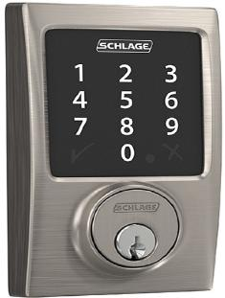
IoT Networking Technologies Overview (2 of 3)
Figure 13-2 A Zigbee-enabled smart lock

Slide 14
IoT Networking Technologies Overview (3 of 3)
Wired technologies are sometimes used in IoT—however, wireless dominates the field in most applications (continued)
Z-Wave—is used primarily in home automation to wirelessly connect smart devices such as locks, thermostats, lighting, and security systems
It is a wireless mesh technology that allows devices to communicate with one another and with a central control hub that serves as a gateway to the home Wi-Fi network so devices can be controlled with smart home assistants and smartphones
LoRaWAN—is a low-power wide-area network technology that operates over a wide range of frequencies under 1 GHz

Slide 15
Knowledge Check Activity 13-1
Which type of network might be used to collect data from a consumer utility meter?
a. NAN
b. WAN
c. FAN
d. MAN

Slide 16
Knowledge Check Activity 13-1: Answer
Which type of network might be used to collect data from a consumer utility meter?
Answer: a. NAN
Explanation: Neighborhood area networks (NANs) are primarily used in the utility industry to wirelessly collect data from utility meters. NAN technologies can reach distances of dozens of kilometers and have low bandwidth requirements. A similar network type, a field area network (FAN), is also used in utility applications and works with NAN technologies. Whereas NAN technologies connect from the consumer endpoint to the utility network, FAN technologies connect utility network nodes with one another.

Slide 17
Home Automation and Industrial IoT Devices
Industrial IoT (IIoT) uses some of the same technologies as other IoT devices but differs in many aspects, such as security, ruggedness, networking, and the types of devices involved
IIoT is used in utilities, energy, healthcare, manufacturing, city infrastructure, and other industries
This section introduces you to common IoT devices and use cases from both commercial and industrial sectors of IoT

Slide 18
A Sampler of Home Automation IoT Devices (1 of 3)
Popular IoT devices used in the home and office include:
Smart home assistants
Smart thermostats, smart vents, smart light bulbs, smart door locks
Video doorbells
Smoke alarms
Garage door openers and security systems
Irrigation systems
Smart appliances

Slide 19
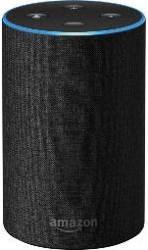
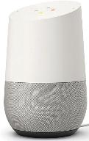
A Sampler of Home Automation IoT Devices (2 of 3)
Figure 13-3 Amazon Echo
Figure 13-4 Google Home

Slide 20
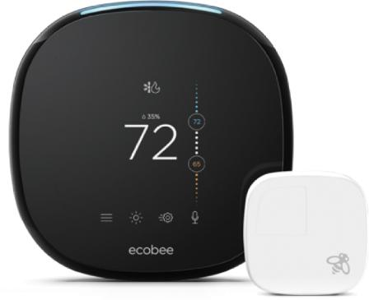
A Sampler of Home Automation IoT Devices (3 of 3)
Figure 13-5 ecobee smart thermostat

Slide 21
Industrial IoT Devices (1 of 6)
The use of IoT technologies in industry has been dubbed Industry 4.0
Industry 4.0 makes use of virtualization, cloud computing, and artificial intelligence to create what is called a cyber-physical system (CPS)
Some of the same IoT technologies are used in both home automation and industry
Industrial usage often requires industrial versions of sensors because they must hold up under harsh environments, high vibrations, and possibly extreme temperatures

Slide 22
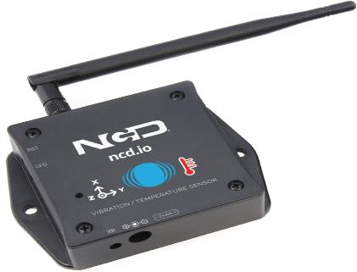
Industrial IoT Devices (2 of 6)
Figure 13-7 An industrial IoT wireless vibration sensor

Slide 23
Industrial IoT Devices (3 of 6)
Types of devices you might find in industrial applications include the following:
Actuators—a general category of output device that provides automatic movement, such as turning a valve to open or close a pipe
Electric motor—rotates at a particular speed and direction in response to an electrical signal
Stepper motors rotate in a series of steps, providing precise movement
Servo motors provide either partial rotation or continuous rotation
Solenoid—a tightly wound coil of wire that creates a strong magnetic field when electricity is applied

Slide 24
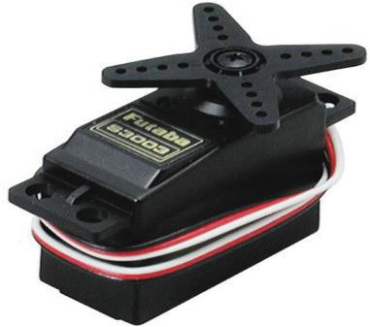
Industrial IoT Devices (4 of 6)
Figure 13-8 A servo motor

Slide 25
Industrial IoT Devices (5 of 6)
Types of devices you might find in industrial applications include the following (continued):
RFID tags—attached to objects and are used to identify and track the objects
PLCs—programmable logic controllers (PLCs) are input/output controllers used in assembly lines, robotics, and automated machinery
IoT gateways—devices that translate data coming from an IoT network to another type of network
youtube.com/watch?v=wCycn_4VEe4
Buildings & IoT – friends?

Slide 26
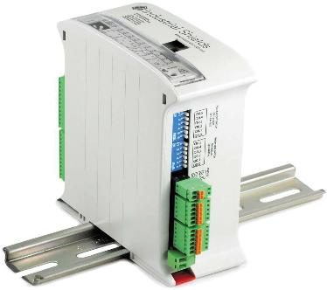
Industrial IoT Devices (6 of 6)
Figure 13-9 An IoT-enabled PLC

Slide 27
DIY IoT (1 of 3)
Part 2
Examples of DIY IoT:
Studying changes in rock density due to atmospheric conditions
Measuring how many hours of direct sunlight your plants are getting
Creating a wildlife detection and alarm system
youtube.com/watch?v=dVG8W-0p6vg
Tech Promised Everything. Did it deliver? - July 2025

Slide 28
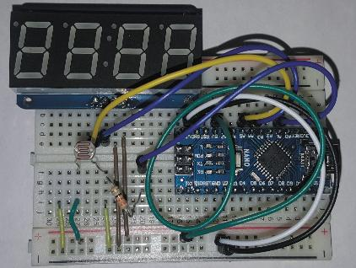
DIY IoT (2 of 3)
Figure 13-10 A sunlight detection IoT device

Slide 29
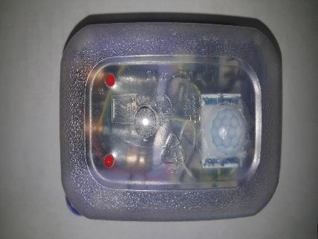
DIY IoT (3 of 3)
Figure 13-11 A wildlife detection and alarm IoT device

Slide 30
Getting Started with IoT (1 of 6)
Companies that cater to the DIY crowd:
Sparkfun—www.sparkfun.com
Adafruit—www.adafruit.com
Sparkfun partners with educational institutions to offer webinars, curricula, instructor training, and lab kits
Tinkercad from Autodesk allows you to start experimenting with IoT without any investment in hardware or equipment by using an online circuit simulator

Slide 31
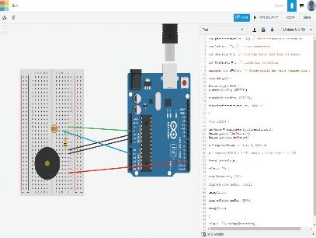
Getting Started with IoT (2 of 6)
Figure 13-12 A circuit in Tinkercad

Slide 32
Getting Started with IoT (3 of 6)
The following is a list of items you’ll likely need to get started with IoT:
Microcontroller development board
Solderless breadboard—a development tool into which you plug components, giving you access to the computer’s input and output lines
Sensors—common sensors include LDRs, PIRs, temperature sensors, accelerometers, infrared receivers, force sensors, and audio sensors
LEDs—light-emitting diodes (LEDs) are small electronic devices that emit light when an electrical current is applied
LEDs are used as indicator lights

Slide 33
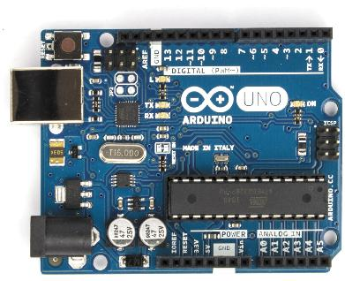
Getting Started with IoT (4 of 6)
Figure 13-13 An Arduino Uno

Slide 34
Getting Started with IoT (5 of 6)
The following is a list of items you’ll likely need to get started with IoT (continued):
Actuators
Display components
Passive components – such as resistors, capacitors, and diodes are part of most electronic designs
Power supply
Jumper wire - a short length of insulated wire that has a pin or socket on each end and is used to conduct electricity from one component to another

Slide 35
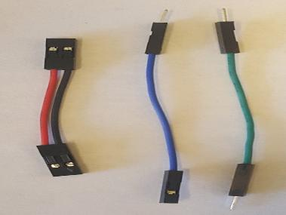
Getting Started with IoT (6 of 6)
Figure 13-15 Jumper wire

Slide 36
Tools for IoT
You will likely need some basic tools during the development process:
Wire cutters
Soldering iron
Digital voltmeter
Helping hands—a tool with alligator clips on the end of articulating arms that hold things in place

Slide 37
IoT Software Development (1 of 6)
Most microcontroller development boards have an associated integrated development environment (IDE)
An IDE allows you to write, edit, debug, and prepare programs for upload to the development board for execution by the microcontroller
This chapter focuses on the Arduino IDE, which is designed specifically for writing programs for Arduino and Arduino-compatible development boards
You write programs in the Arduino IDE using the C and C++ languages
The IDE has downloadable libraries to support sensors, actuators, network interfaces, and other I/O devices

Slide 38
IoT Software Development (2 of 6)
An Arduino program is called a sketch
When you start a new one, the IDE fills in the basic structure that all sketches use:
setup()—When you download an Arduino sketch, the microcontroller begins by executing the code in the setup() section
This section is used to initialize devices and perform other tasks that should only be executed once for the duration of the program
loop()—The loop section is where the main program code resides

Slide 39
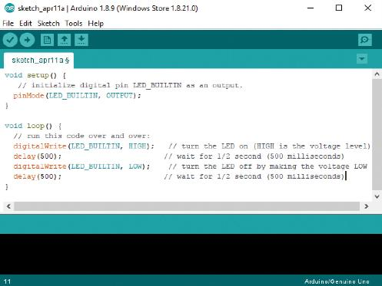
IoT Software Development (3 of 6)
Figure 13-17 An Arduino program that blinks an LED

Slide 40
IoT Software Development (4 of 6)
IoT Development with Python
There are variations of Python for microcontrollers, including MicroPython and CircuitPython
Development boards that support Python have more flash and RAM and usually run at higher clock rates than those that are meant to support only the Arduino environment
Python is an interpreted language and the interpreter uses flash and RAM on the development board

Slide 41
IoT Software Development (5 of 6)
IoT with Raspberry Pi
The Raspberry Pi 3 is a full-featured personal computer on a single board the size of a credit card
It has a quad-core, 1.4 GHz processor and was designed for more complex tasks
It runs the Linux OS, a distribution called Raspbian, and has Python built in
It is best suited for running computing-intensive applications, collecting data from microcontroller-based IoT devices, Web server-based projects, and so forth

Slide 42
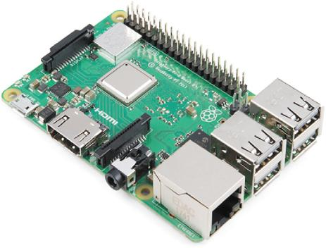
IoT Software Development (6 of 6)
Figure 13-18 A Raspberry Pi 3B+
youtube.com/watch?v=WEMffdUgWCk
analog life in a digital world

Slide 43
Knowledge Check Activity 13-2
Which type of device might be used to move a robotic arm up and down?
a. Actuator
b. Servo motor
c. Solenoid
d. PLC

Slide 44
Knowledge Check Activity 13-2: Answer
Which type of device might be used to move a robotic arm up and down?
Answer: b. Servo motor
Explanation: Servo motors provide either partial rotation (usually about 180 degrees) or continuous 360-degree rotation, and often contain feedback sensors to read the servo’s position. The spindle on a servo motor allows the attachment of an arm that can be used to move objects up and down, left and right, and so forth.

Slide 45
Self Assessment
Describe some of the IoT devices you have in your home.
What kind of sensor might be used by a controller that’s designed to keep the moisture in the air at a constant level?

Slide 46
Summary
Now that the lesson has ended, you should be able to:
Define the Internet of Things and list use cases
Describe IoT network technologies
Discuss a variety of IoT devices
Utilize DIY IoT devices

